Slide 1
Biochem 3BP3 Evolutionary Biology
Molecular evolution is a large sub-discipline
Bioinformatics plays a major role in evolutionary biology
Examples:
Evolution of drug resistance
Gene duplication and functional diversification
Host-pathogen co-evolution
Biochem 3BP3 is going to focus on phylogenetics – how genes are related as a guide to nomenclature and functional prediction

Slide 2
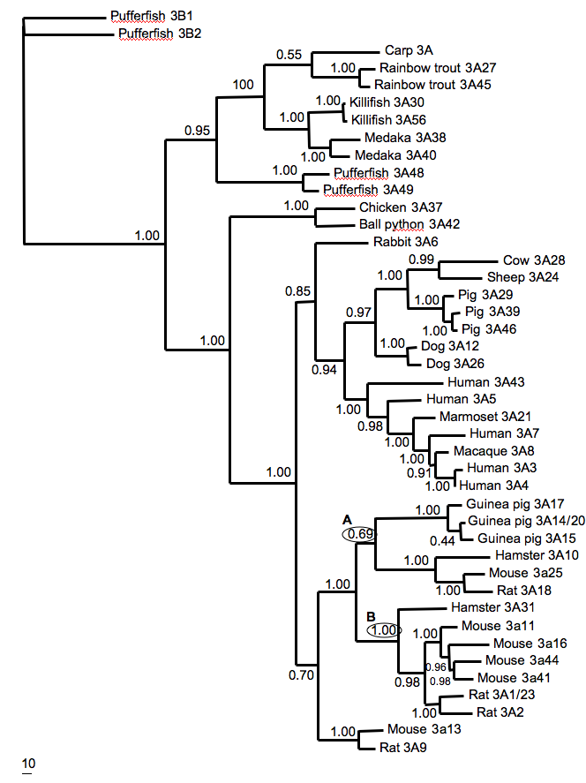
An Example: CYP3A Phylogeny
McArthur et al. 2003. J. Mol. Evol. 57: 200-211.

Slide 3
An Example: CYP3A Phylogeny
Outgroup choice is important
McArthur et al. 2003. J. Mol. Evol. 57: 200-211.

Slide 4
An Example: CYP3A Phylogeny
Outgroup choice is important
Trees can reflect gene duplication
McArthur et al. 2003. J. Mol. Evol. 57: 200-211.

Slide 5
An Example: CYP3A Phylogeny
Outgroup choice is important
Trees can reflect gene duplication
Trees can reflect speciation
McArthur et al. 2003. J. Mol. Evol. 57: 200-211.

Slide 6
An Example: CYP3A Phylogeny
Outgroup choice is important
Trees can reflect gene duplication
Trees can reflect speciation
Trees can be a combination of gene trees and species trees
McArthur et al. 2003. J. Mol. Evol. 57: 200-211.

Slide 7
An Example: CYP3A Phylogeny
Outgroup choice is important
Trees can reflect gene duplication
Trees can reflect speciation
Trees can be a combination of gene trees and species trees
Trees should include confidence estimates
McArthur et al. 2003. J. Mol. Evol. 57: 200-211.

Slide 8
An Example: CYP3A Phylogeny
Outgroup choice is important
Trees can reflect gene duplication
Trees can reflect speciation
Trees can be a combination of gene trees and species trees
Trees should include confidence estimates
Trees include estimates of evolutionary distance
McArthur et al. 2003. J. Mol. Evol. 57: 200-211.

Slide 9
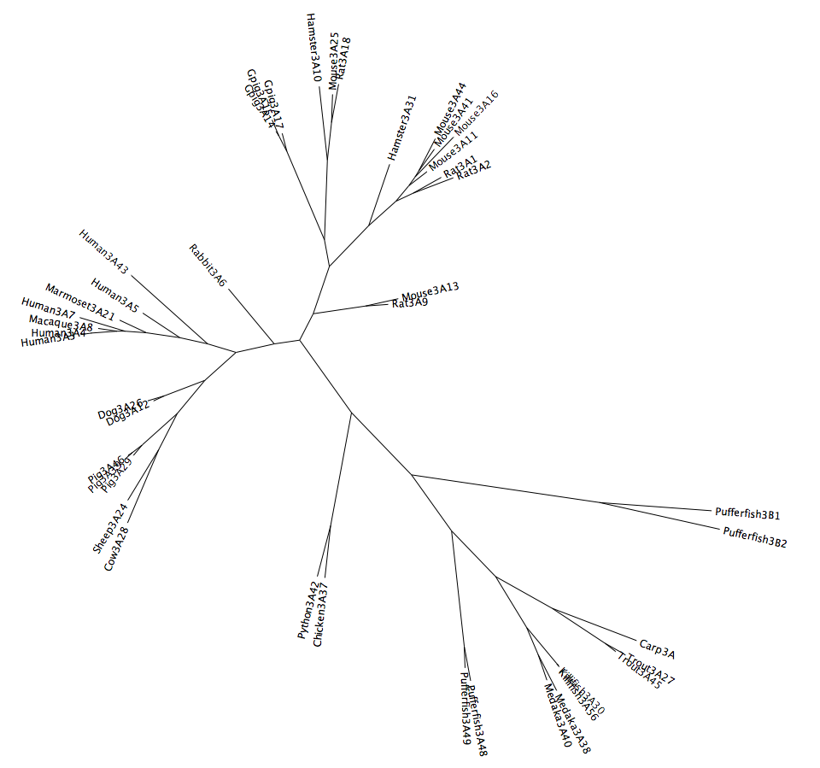

An Example: CYP3A Phylogeny
This is the same tree, just drawn differently
Outgroup choice is important
Trees can reflect gene duplication
Trees can reflect speciation
Trees can be a combination of gene trees and species trees
Trees should include confidence estimates
Trees include estimates of evolutionary distance
Branch lengths are a function of time and rate of evolution – evolutionary clocks are local (aka “soft”)
Dali, Persistence of Time

Slide 10
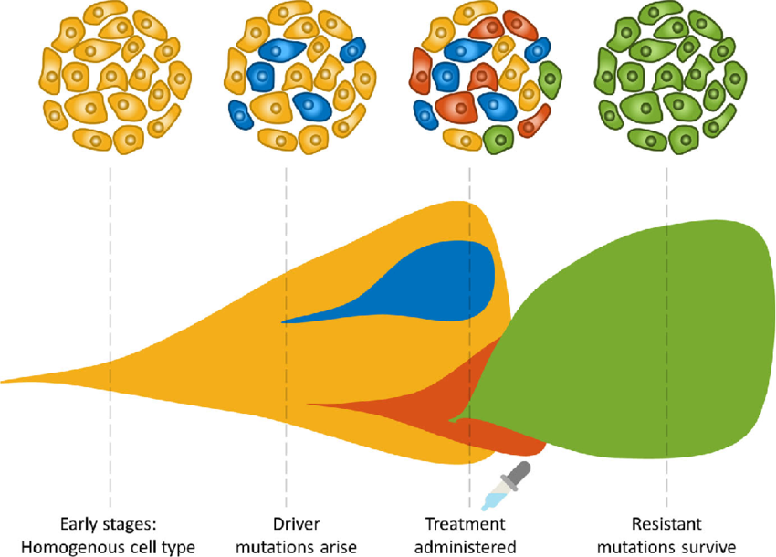
Phylogenetic relationships between tumour cells
Tumours are not a uniform ”blob” of cells

Slide 11
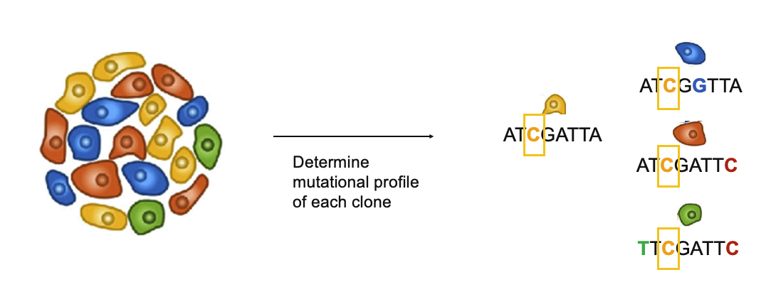
Phylogenetic relationships between tumour cells
Tumours are not a uniform ”blob” of cells
Diverse mix of tumour (and non-tumour) cells each with unique set of DNA mutations
Cells can respond differentially to treatment

Slide 12
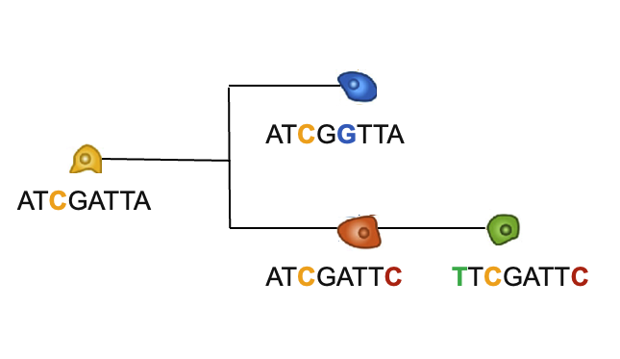
Phylogenetic relationships between tumour cells
Tumours are not a uniform ”blob” of cells
Diverse mix of tumour (and non-tumour) cells each with unique set of DNA mutations
Cells can respond differentially to treatment

Slide 13
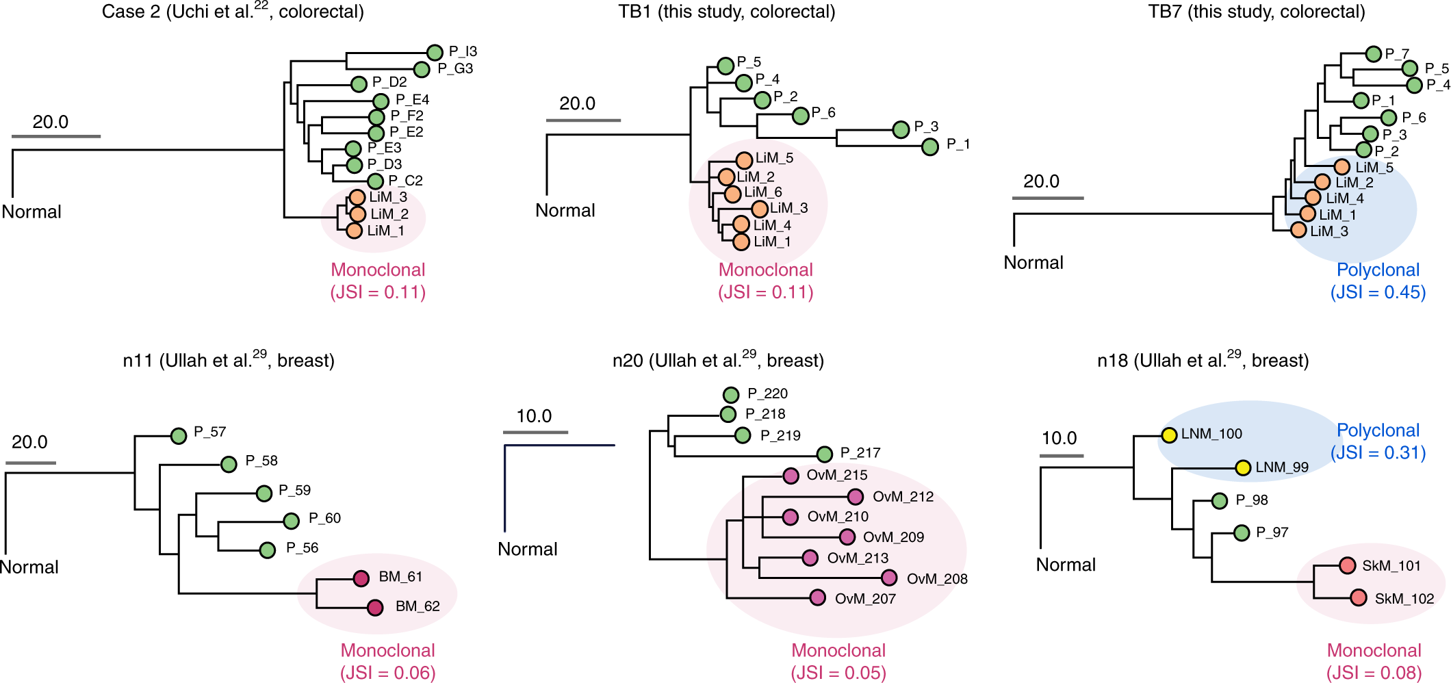
Phylogenetic relationships between tumour cells
Hu et al. Nature Genetics (2020)

Slide 14
Substitution & Rates of Evolution
Ancestral Sequence

Slide 15
Substitution & Rates of Evolution
Ancestral Sequence
gene duplication
t
t = time
Sequence 1
Sequence 2

Slide 16
Substitution & Rates of Evolution
A
No Change
gene duplication
t
t
A
A

Slide 17
Substitution & Rates of Evolution
A
Single Substitution
gene duplication
t
t
C
A

Slide 18
Substitution & Rates of Evolution
A
Multiple Substitutions
gene duplication
T
Unequal rates of evolution
False sequence similarity!
C
C
If rates of evolution were slow and equal, change would be rare and phylogenetics would be much easier. As they are not, one of the primary issues of phylogenetics is to determine history despite multiple substitution.

Slide 19
Key Issues of Phylogenetics
How do we find homologous sites?
How do we model substitution?
How do we search for the best tree?

Slide 20
Key Issues of Phylogenetics
How do we find homologous sites?
How do we model substitution?
How do we search for the best tree?
HOMOLOGOUS
A homologous trait is shared between two species because they inherited it from a common ancestor.
Information from homologous traits can be used to infer evolutionary relationships.
Non-homologous traits do not reflect evolutionary history but instead convergence. They can mislead inference of evolutionary relationships. Example: octopus eye versus human eye.

Slide 21
Multiple Sequence Alignment
Alignment of highly similar sequences is easy – each column is assumed to reflect a homologous position in the protein
Blocks of identical sequence
Gaps infrequent
Substitutions conservative (i.e. leucine versus isoleucine)
Clustal software very effective in generating alignments

Slide 22
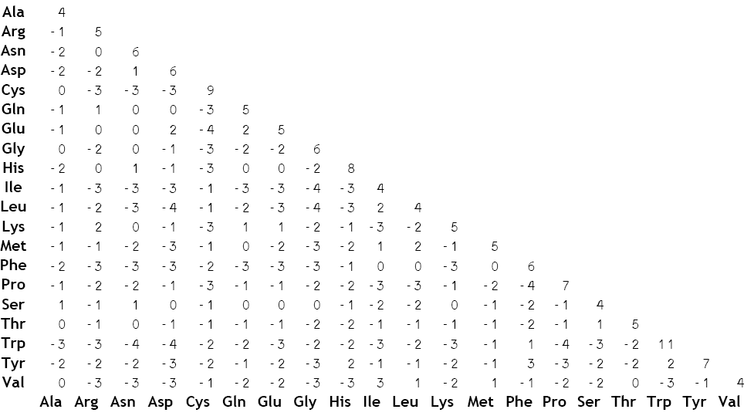
Multiple Sequence Alignment
Just like BLAST, alignment software like Clustal uses BLOSUM, PAM, or other empirical substitution matrices to model conservative amino acid substitutions. Different matrices can be used for different evolutionary timescales.

Slide 23
Multiple Sequence Alignment
Clustal and related methods can handle up to ~70% sequence divergence when BLOSUM or other matrices are used. Insertion and deletions of amino acids (INDELs) are the challenge.
Divergence beyond 70% takes special algorithms, often using protein structure prediction to guide alignment. Important for generating seed alignments for HMMs!

Slide 24
. = same amino acid, * = conservative change, : = semi-conservative change
- = gap; SRS = substrate recognition site
Pufferfish 3B1 MFEFVLFSGTTWALLALFFALLLLYGVWPYHHFKKLGIRGPRPLPFMGSTFYYRKGIIPFESWCQAEYGDVWGMFEGRTPVLMVSDPEILKTVLVKECYS
Killifish 3A30 .G-YFYLTAE..T..VA.VT...V.AY...GT..R...S..K.V..F.TMLH..R.FFT.DEE.KKK..K...IYD..Q...C.T....I.A......L.
Pig 3A29 .DLIPG..TE..V...TSLV..Y...TYSHGL......P......YF.NILG....VDH.DKK.FQQ..KM..VYD..Q.L.A.T..NMI.S........
Human 3A4 .ALIPDLAME..L...VSLV..Y...THSHGL......P..T....L.NILS.H..FCM.DME.HKK..K...FYD.QQ...AIT..DMI..........
Rat 3A18 .EIIPNL.IE..V...TSLM.FYI..TYSHGL......P..K.V.LF.TI.N.GD.MWK.DDD.YKK..KI..FY..PQ.F.AIM....I.M........
Rat 3A1 .DLLSALTLE..V...VVLV..YGF.TRTHGL...Q..P..K....F.TVLN.YM.LWK.DVE.HKK..KI..L.D.QM.LFAIT.T.MI.N......F.
* :: * :: *: * : *: ** * * * * : * :* ** :: * : : :: :*:*:*
Pufferfish 3B1 VFTNRRD-SFAGPLEDSVSAVKDERWKRIRSTISPCFTSGRLKNAFPIVARYADRITKKLE-QSNLDEPINVKEFLAPYSLDAVTSVSFSVEADSINNPN
Killifish 3A30 F.....NFRLN...Y.A..IAE.DQ......VL..S.......EM.E.MKNHSANLIRSMKKKADK...LDL...FGS..M.V...TA...DI..L...S
Pig 3A29 ......SFGPL.AMRNAL.LAE..E.....TLL..T....K..EM...ISH.G.LLVSN.RKEAEKGK.VTM.DIFGA..M.VI..TA.G.NI..L...Q
Human 3A4 ......PFGPV.FMKSAI.IAE..E...L..LL..T....K..EMV..I.Q.G.VLVRN.RREAETGK.VTL.DVFGA..M.VI..T..G.NI..L...Q
Rat 3A18 ......CFGPM.FMKKAITMSE..E...L.TIL..T....K..EM..LMRQ.G.TLL.N.RREEAKG....M.DIFGA..M.VI.GT..G.NV..L...Q
Rat 3A1 .......FGPV.IMGKA..VA...E...Y.ALL..T.......EM...IEQ.G.ILV.Y.KQEAETGK.VTM.KVFGA..M.VI..T..G.NV..L...K
***: * : :: :: *:* * :* **: ::: : : : * : * :* : * * **: :*
Pufferfish 3B1 DPLIVNLKKVFK-FNFVVFFLVAFFPFCARLFQFLGIDPIPRSSVNYFYNVIKNFKDQHHADTRG---DFLQVLIQSEIP--QSEIKSPKGLTEHEILSQ
Killifish 3A30 ..FVT.I..ML.D.LNPL.LA......LGPILEKFELSFF.K.VTDF..ASLEKI.SNRE.SQQKSRV....LM.D.Q--KNS-GAQQD.S..D......
Pig 3A29 ..FVE.S..LL.S.FDPFLLSLI....LTPI.EV.N.TLF.K....F.TKSV.RM.ESRLT.QQKRRV.L..LM.N.Q---NSK.MDPH.S.SNE.LVA.
Human 3A4 ..FVE.T..LLRD.LDPF.LSITV...LIPILEV.N.CVF..EVT.FLRKSV.RM.ESRLE..QKHRV....LM.D.QK--NSK.TE.H.A.SDL.LVA.
Rat 3A18 ..FVQKA..IL.QIFDPFLLS.VL...LTPIYEM.NFSIF..Q.M.F.KKFV.TM.KNRLDSNQKNRV....LMMNTQ---NSKGQE.Q.A.SDL.MAA.
Rat 3A1 ..FVEKT..LLRD.FDPL.LS.VL...LTPIYEM.N.CMF.KD.IEF.KKFVYRM.ETRLDSVQKHRV....LMMNAHN--DSKDKE.HTA.SDM..TA.
:: *: : : :* :: : : ::: :: : : *: *
----F helix----- ----------G helix---------- --H helix- --I helix--
Pufferfish 3B1 AFIFIFGGYETTTTTLTNVLYGLAINPDVLQVLHKEIDTNIPSDAPISYEDLMGLQYLDQVLNESQRLYPTAPRLERACKKTVQIHGLTILEGTIVGIPV
Killifish 3A30 SM....A....SSSS..FLA.N..T..E.MKK.QE...ATF.NK..VH.QP..EME...C.I...L..F.I.A....VA.AA.E.N.VV.PKDMV.M..T
Pig 3A29 GI....A.....SSA.SLLA.E..TH...Q.K.QE..EATF.NK..PT.DA.AQME...M.V..TL....I.A........D.E...VFVPK..V.VV..
Human 3A4 SI....A.....SSV.SFIM.E..TH...Q.K.QE...AVL.NK..PT.DTVLQME...M.V..TL..F.I.M....V...D.E.N.MF.PK.WV.M..S
Rat 3A18 .I.......DA.S.SISFIM.E..TR.N.QKK.QN...RAL.NK..VT.DA..EME...M.V...L....I.T..D.VS..D.E.N.VF.PK..V.T..I
Rat 3A1 SI....A...P.SS..SF..HS..TH..TQKK.QE...RAL.NK..PT.DTV.EME...M....TL....IGN....V...D.E.N.VFMPK.SV.M..S
:: *: :: : : *: : **: :* : ::*** :* *: : * * :: * : * :*
---------------I helix---------------
Pufferfish 3B1 HLLHKDPRFWSSPEEFRPERFSKDSTEEVNPYAFMPFGLGPRNCVGMRYAILVMKMLIVRLLQSYTVETCKDTMIPLEFDWK--SQPLKPIKLSFIPRQK
Killifish 3A30 WP..R..EI.PE..A.K......KNKDNID..IY....S.....I...F.LVLI.LAV.EI..Q.SFSV..E.EV.F.M.IQGLLA.KR..Q.KLV..S
Pig 3A29 FV..R..DL.PE...........KHKDTI...TYL...T.....I...F.LMN..LAL..V..NFSFKP..E.Q...KLTTQGLT..E..VV.KIL..DG
Human 3A4 YA..R..KY.TE..K.L......KNKDNID..IYT...S.....I...F.LMN..LALI.V..NFSFKP..E.Q...KLSLGGLL..E..VV.KVES.DG
Rat 3A18 YP..RN.EY.LE....N......ENKGSID..VYL...N.....I...F.LIS..LAVIGV..NFNIQP.EK.Q...KISRQPIF..EG..I.KLVS.D
Rat 3A1 YA..R..QH.PE...........ENKGSID..VYL...N.....I...F.LMN..LALTKV..NFSFQP..E.Q...KLSRQGLL..T...I.KVV..DE
:: * *: * *****: : * : *** *****:* * *: :*: : :* : * * : : : * *
--Heme binding--
SRS 1
SRS 2
SRS 3
SRS 4
SRS 5
SRS 6
Conservative & semi-conservative labels based on alignment of 50+ sequences

Slide 25
Multiple Sequence Alignment
Alignment involves appropriate substitution models
Alignment of divergent sequences may require structural constraints (e.g. rRNA folding) or special algorithms (e.g. MUSCLE)
Any alignment may have sub-sections that are poorly aligned and should be removed from phylogenetic analyses as HOMOLOGY is uncertain (i.e. not sure if all amino acids in the column reflect the same ancestral position in the protein).

Slide 26
Key Issues of Phylogenetics
How do we find homologous sites?
How do we model substitution?
How do we search for the best tree?
Modeling substitution and finding the best tree are intertwined in a concept called the “optimality criteria” – the philosophical / mathematical / computational framework you use to find the best (aka optimal) phylogenetic tree

Slide 27
Optimality Criteria
PARSIMONY
DISTANCE METHODS (aka neighbour-joining, minimum evolution)
MAXIMUM LIKELIHOOD
BAYESIAN INFERENCE

Slide 28
Optimality Criteria
DISTANCE METHODS (aka neighbour-joining, minimum evolution)
Simplify a multiple sequence alignment to a distance matrix
Loss of information; unreliable method
But it is very fast, so often used as a first-pass estimate (e.g. our BLAST detection of a pmr contaminant)
BEWARE publications with neighbour-joining trees!

Slide 29
Optimality Criteria
PARSIMONY
DISTANCE METHODS (neighbour-joining, minimum evolution)
MAXIMUM LIKELIHOOD
BAYESIAN INFERENCE

Slide 30
Ignoring Multiple Substitutions: Parsimony
A
A
?
A
?
A
C
G
Parsimony is Occam’s Razor, i.e. the simplest explanation is the easiest
Parsimony seeks to minimize the number of substitutions

Slide 31
Ignoring Multiple Substitutions: Parsimony
A
A
A
A
?
A
C
G
No changes required to explain the adenosines

Slide 32
Ignoring Multiple Substitutions: Parsimony
A
A
A
A
C
A
C
G
Score: Two changes

Slide 33
Ignoring Multiple Substitutions: Parsimony
A
A
A
A
A
A
C
G
Score: Two changes

Slide 34
Ignoring Multiple Substitutions: Parsimony
A
A
A
A
G
A
C
G
Score: Two changes

Slide 35
Ignoring Multiple Substitutions: Parsimony
A
A
A
A
T
A
C
G
Score: Three changes

Slide 36
Ignoring Multiple Substitutions: Parsimony
A
A
A
A
C/G/A
A
C
G
NO SUBSTITUTION MODEL!
3 of 4 possible bases are equally parsimonious!
LACK OF RESOLUTION!
Parsimony is fast since it only needs to count change but it deals poorly with multiple substitutions or unequal rates of evolution – it often lacks resolution

Slide 37
Key Issues of Phylogenetics
PARSIMONY
DISTANCE METHODS (neighbour-joining, minimum evolution)
MAXIMUM LIKELIHOOD
BAYESIAN INFERENCE

Slide 38
Accounting for Multiple Substitutions: Likelihood
A
A
?
A
?
A
C
G
Maximum likelihood (ML) does not apply Occam’s Razor
ML uses substitution models to better predict which changes have occurred
In ML, the length of the branches is as important as the shape of the tree

Slide 39
Accounting for Multiple Substitutions: Likelihood
A
A
A
A
?
A
C
G
No changes required to explain the adenosines

Slide 40
Accounting for Multiple Substitutions: Likelihood
A
A
A
A
A
A
C
G
A is the most likely as it is the shortest route

Slide 41
Accounting for Multiple Substitutions: Likelihood
A
A
A
A
A>c
A
C
G
C is the next most likely as it is the next shortest route

Slide 42
Accounting for Multiple Substitutions: Likelihood
A
A
A
A
A>c>g
A
C
G
G is the third most likely as it is the third shortest route

Slide 43
Accounting for Multiple Substitutions: Likelihood
A
A
A
A
A>c>g>t
A
C
G
BRANCH LENGTHS (e.g. shortest route) COME FROM A SUBSTITUTION MODEL
A SUBSTITUTION MODEL ADDS RESOLUTION!
Each possible solution has a likelihood and must be considered – ML is more complex, slower, but more accurate

Slide 44
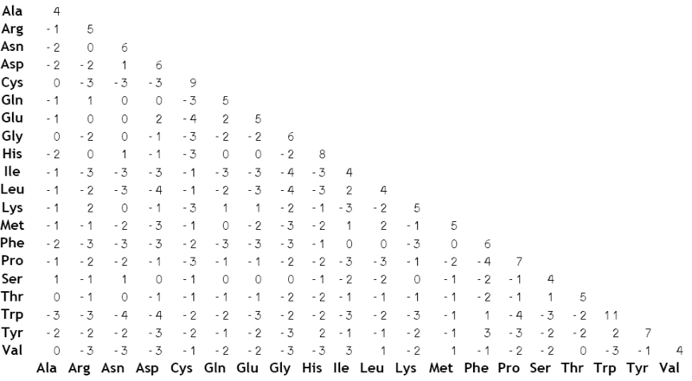
Substitution Models
Empirical
Theoretical
A
C
G
T
ProtTest 3: fast selection of best-fit models of protein evolution. Bioinformatics 27:1164-5.
A
μπ_{C}a
μπ_{G}b
μπ_{T}c
jModelTest: phylogenetic model averaging. Molecular Biology and Evolution 25: 1253-1256.
C
μπ_{G}d
μπ_{T}e
There are wide diversity of substitution models that can be used and you can design your own. Key aspects:
Unequal rates of substitution
Unequal amino acid / nucleotide frequencies
G
μπ_{T}f
T

Slide 45
Key Issues of Phylogenetics
How do we find homologous sites?
How do we model substitution?
How do we search for the best tree?
The “best tree” is a function of the data (i.e. multiple sequence alignment) and substitution model.
bad alignment = bad tree
bad model = bad tree

Slide 46
Key Issues of Phylogenetics
Number of Sequences | Number of Trees
10 | 2 x 10⁶
22 | 3 x 10²³
50 | 3 x 10⁷⁴
100 | 2 x 10¹⁸²
1,000 | 2 x 10^{2,860}
The “search space” in phylogenetics is huge! We cannot search all of it.
Yet we need to find the tree with the best “score”
Two tasks:
Scoring trees
Searching trees

Slide 47
Scoring a Single Tree
A
A
A
A
A>c>g>t
A
C
G
SCORE
A
C
G
T
A
μπ_{C}a
μπ_{G}b
μπ_{T}c
C
μπ_{G}d
μπ_{T}e
G
μπ_{T}f
T

Slide 48
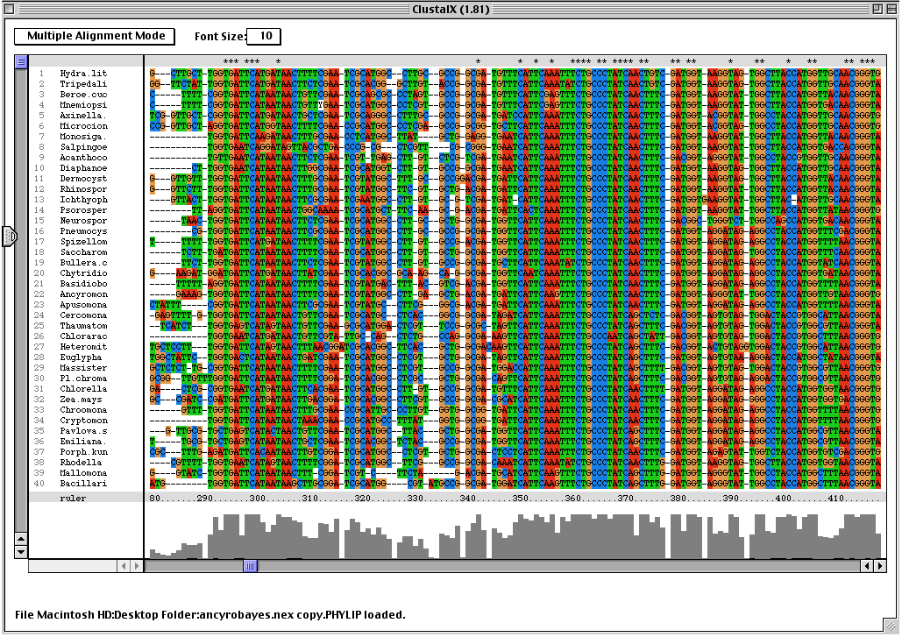
Scoring a Single Tree
A
A
A
A
A>c>g>t
A
C
G
SCORE
A
C
G
T
A
μπ_{C}a
μπ_{G}b
μπ_{T}c
C
μπ_{G}d
μπ_{T}e
G
μπ_{T}f
T
Each site (i.e. column) contributes to the score given the substitution model

Slide 49
Scoring a Single Tree
A
A
A
A
Among Site Rate Variation
A>c>g>t
A
Each site (i.e. column) does not contribute equally
C
G
SCORE
A
C
G
T
A
μπ_{C}a
μπ_{G}b
μπ_{T}c
C
μπ_{G}d
μπ_{T}e
G
μπ_{T}f
T
Each site (i.e. column) contributes to the score given the substitution model

Slide 50
Scoring Requires:
A tree topology to score
Multiple sequence alignment
Substitution model
Unequal rates of substitution among amino acids or nucleotides
Unequal frequencies of amino acids or nucleotides
Incorporation of among-site rate variation
Recognize and model that different parts of a protein (e.g. binding site, globular domains, structural regions, functional domains) will evolve at different rates
Each column in the multiple sequence alignment thus has a faster or slower version of the substitution model
Caveats
Phylogenetic models generally work well even though they are an over-simplification
All methods assume neutrality or near-neutrality; positive selection is problematic
The methods break down when your data has extremes, e.g. fundamentally different rules of evolution in different parts of your protein

Slide 51
How Do We Find The Best Tree?
Number of Sequences | Number of Trees
10 | 2 x 10⁶
22 | 3 x 10²³
50 | 3 x 10⁷⁴
100 | 2 x 10¹⁸²
1,000 | 2 x 10^{2,860}
We can’t score them all – it would take far too long!
Instead, we use “tree space” search algorithms

Slide 52
Key Issues of Phylogenetics
PARSIMONY
DISTANCE METHODS (neighbour-joining, minimum evolution)
MAXIMUM LIKELIHOOD – branch swapping, find the best tree
BAYESIAN INFERENCE – MC³, sample the cloud of best trees
– Bayesian is an extension of maximum likelihood
– not going to cover this in Biochem 3BP3

Slide 53
Branch Swapping
Best tree
Random starting tree

Slide 54
Branch Swapping

Slide 55
Branch Swapping
branch
swapping

Slide 56
Branch Swapping

Slide 57
Branch Swapping

Slide 58
Branch Swapping

Slide 59
Branch Swapping

Slide 60
Branch Swapping

Slide 61
Branch Swapping
Best tree
Local optima

Slide 62
Branch Swapping
Best tree
Replicates!
Each with a different random starting tree

Slide 63
Key Issues of Phylogenetics
PARSIMONY
DISTANCE METHODS (neighbour-joining, minimum evolution)
MAXIMUM LIKELIHOOD – branch swapping, find the best tree
– never examine the majority of trees!
– how many branch swapping replicates to
avoid local optima?

Slide 64
Key Issues of Phylogenetics
PARSIMONY
DISTANCE METHODS (neighbour-joining, minimum evolution)
MAXIMUM LIKELIHOOD – branch swapping, find the best tree
– never examine the majority of trees!
– how many branch swapping replicates to
avoid local optima?
– what about confidence? bootstrap!

Slide 65
Maximum Likelihood & Bootstrapping
branch swapping,
with replication
Best Tree!

Slide 66
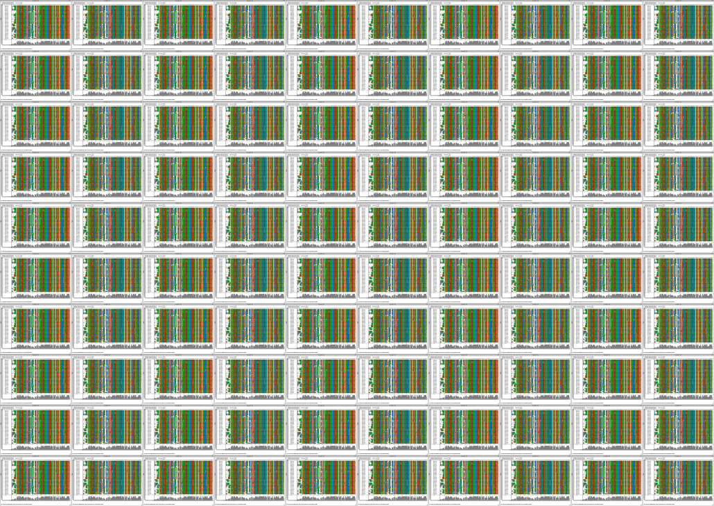
Maximum Likelihood & Bootstrapping
resampling with replication
branch swapping,
with replication
Best Tree!
Consensus Tree of 100 bootstraps

Slide 67
Maximum Likelihood & Bootstrapping
This monophyletic clade was found in 38 of 100 ML bootstraps – not a great result
resampling with replication
This monophyletic clade was found in 96 of 100 ML bootstraps – great support!
Best Tree!
Consensus Tree

Slide 68
Key Issues of Phylogenetics
PARSIMONY
DISTANCE METHODS (neighbour-joining, minimum evolution)
MAXIMUM LIKELIHOOD – branch swapping, find the best tree
– never examine the majority of trees!
– how many branch swapping replicates to
avoid local optima?
– what about confidence? bootstrap!
– bootstrap is computationally expensive!

Slide 69
Key Issues of Phylogenetics
PARSIMONY
DISTANCE METHODS (neighbour-joining, minimum evolution)
MAXIMUM LIKELIHOOD – branch swapping, find the best tree
– never examine the majority of trees!
– how many branch swapping replicates to
avoid local optima?
– what about confidence? bootstrap!
– bootstrap is computationally expensive!
WHAT ABOUT BIG TREES?

Slide 70
RAxML – fast tree space searching, but local or sub-optima more likely
Kirischian et al. 2011. J. Mol. Evol. 72: 56-71.
Stamatakis (2006). RAxML-VI-HPC: maximum likelihood-based phylogenetic analyses with thousands of taxa and mixed models.
Bioinformatics 22: 2688-2690.

Slide 71
Conclusions
Phylogenetics is not a black box method
Be skeptical of distance (NJ) and parsimony trees
Be aware of the assumptions and pitfalls
how good is the alignment?
all sites homologous?
poorly aligned regions removed?
how was the substitution model selected?
which optimality criteria is being used? why?
was the search of tree space robust?
was confidence properly assessed?
any known biases / extremes?
long branch attraction?
composition bias?

Slide 72
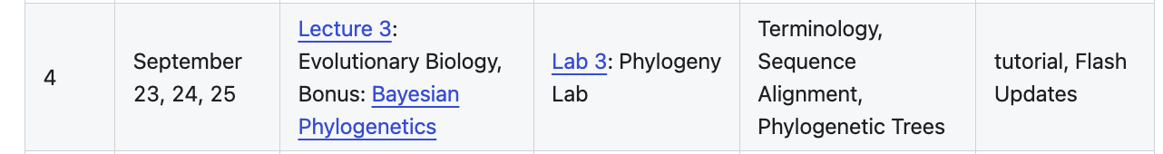
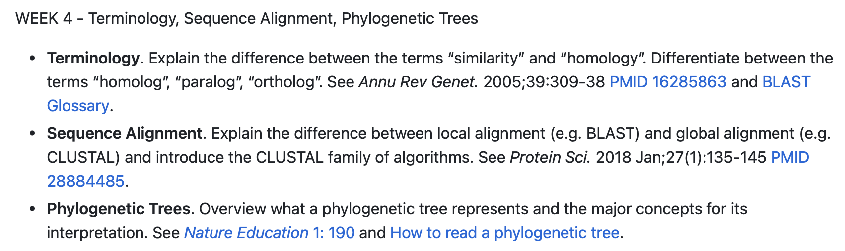
This Week…

